Slide 1
Algorithm complexity
Problems → algorithms → programs
Bounds are for the algorithms, rather than programs
  programs are just implementations of an algorithm, and almost always the details of the program do not affect the bounds
Algorithms are often written in pseudo-codes
  We use ‘almost’ something like C++.
Bounds are for algorithms, rather than problems
  A problem can be solved with several algorithms, some are more efficient than others

Slide 2
Worst- / average- / best-case
Worst-case running time of an algorithm
  The longest running time for any input of size n
  An upper bound on the running time for any input
  ⇒ guarantee that the algorithm will never take longer
  Example: Sort a set of numbers in increasing order; and the data is in decreasing order
  The worst case can occur fairly often
    E.g. in searching a database for a particular piece of information
Best-case running time
  sort a set of numbers in increasing order; and the data is already in increasing order
Average-case running time
  May be difficult to define what “average” means

Slide 3
Asymptotic notations
Upper bound O(g(N)
Lower bound Ω(g(N))
Tight bound Θ(g(N))

Slide 4
Upper bound O(g(N) can be arbitrarily high …
Lower bound Ω(g(N)) can be arbitrarily low …
Most of estimations, often written as O(*), are tight bound Θ(*)
We don’t write Θ(*) because for many algorithms, we don’t know the lower bound, so theoretically it’s not yet the tight bound Θ(*), but the best or the ‘lowest’ upper bound O(*) so far …
To get the tight bound, we need to estimate the lower bound …

Slide 5
Lower bound, usually harder than upper bound to prove, informally,
find one input example (of course, we may find an easier one, but we need to come up with a sufficiently difficult one to accommodate our estimator),
that input has to do ‘at least’ an amount of work
that amount is a lower bound
Consider a sequence of 0, 1, 2, …, N-1, and search for 0
At least log N steps if N = 2^k
An input of size n must take at least log N steps
So the lower bound is Omega(log N)
So the bound is tight, Theta(log N)

Slide 6
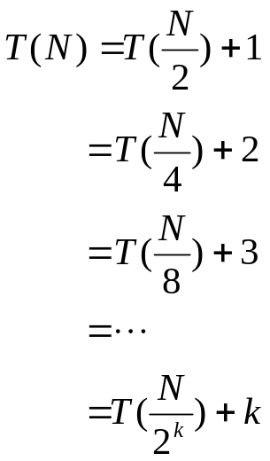

Solving the recurrence for binary search:
With 2^{k} = N (or asymptotically), k=log N, we have
Thus, the running time is O(log N)

Slide 7
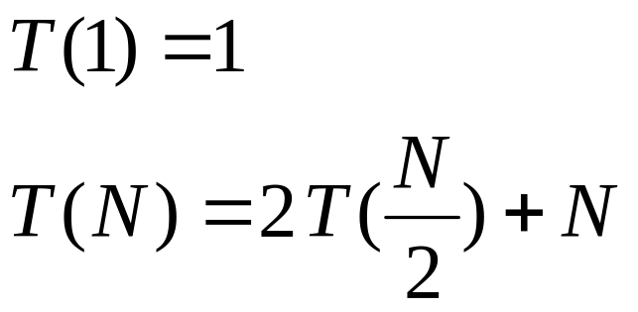
Recurrence for Divide and Conquer with linear:
  2 T(N/2): two subproblems, each of size N/2
  N: for “patching” two solutions to find solution to whole problem

Slide 8
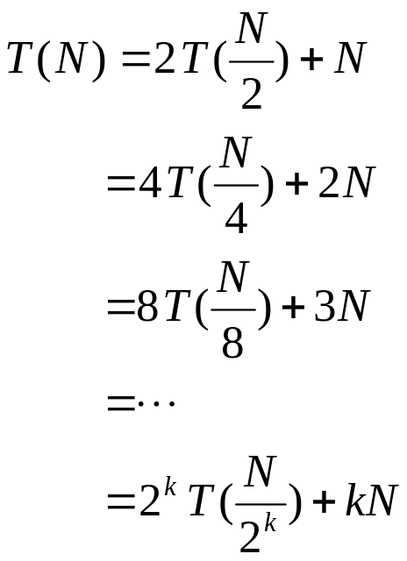
With 2^{k} = N (or asymptotically), k=log N, we have
Thus, the running time is O(N log N)

